Slide 1
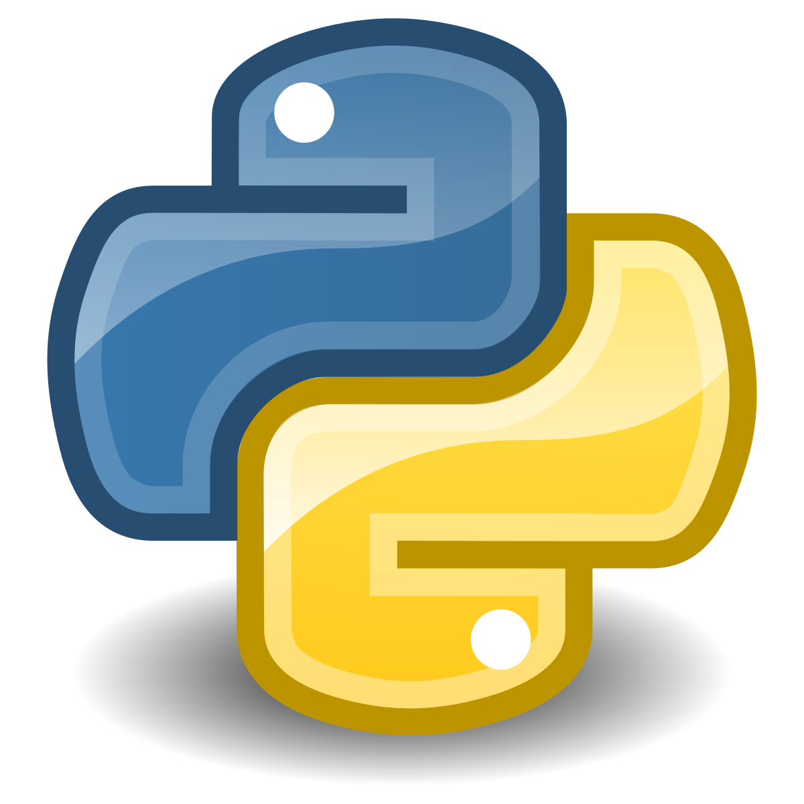
DevSoc Python Workshop 2.0
Peter “constant pain” Lampard

Slide 2
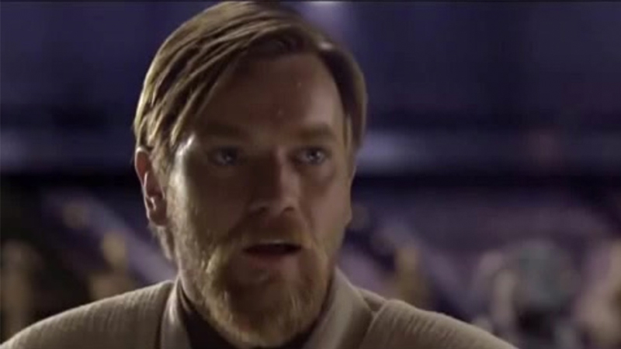
Peter Lampard
2nd Year Software Engineering Student

Slide 3
Arrays
An array is a method of storing multiple items in one variable, as opposed to using a different variable for each item.
It is structured using square brackets, surrounding the list of items with commas between each one.
E.G: myArray = [“Item 1”, “Item 2”, “Item 3”]
In order to access an item from an array, you put the name of the array, then the index of the item (starting from 0)
E.G: myArray[0] would return “Item 1”

Slide 4
Using Arrays
There are a number of methods of interacting with arrays. The most useful ones being “pop” and “append”.
The “pop” method removes the item at the given index of the list. It is structured as arrayName.pop(index)
E.G: If you have the array carArray = [“Subaru”, “Mazda”, “Nissan”] and put carArray.pop(0) it would return “Subaru”
The “append” method adds an item onto the end of the array. It is structured as arrayName.append(“item”)
E.G: If you have the array modelArray = [“Impreza WRX”, “MX5”, “350z”] and put modelArray.append(“RX7”) it would add “RX7” on the end of modelArray.
There are also other methods, such as “remove”, “index”, “reverse” and “sort” which you can look into more here: https://www.w3schools.com/python/python_ref_list.asp

Slide 5
Tuples
A tuple is a collection of items but unlike an array, once created it cannot be altered.
It is structured using round brackets
E.G: myTuple = (“Item 1", “Item 2", “Item 3")
You access the items in a tuple in the same way as an array.
E.G: myTuple[0] would return “Item 1”

Slide 6
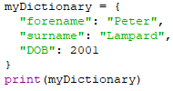
Dictionaries
A dictionary is an indexed collection of items consisting of keys and values.
It is structured using curly brackets and each key/value is split by a colon with a comma after it. For ease of formatting, you can split it across multiple lines when defining it.
E.G:
To access an item from a dictionary, you put the name of the dictionary, then the name of the “key” for the item.
E.G: To access the value of “forename” in the dictionary, you would put myDictionary[“forename”] as “forename” is the key. This would return “Peter”

Slide 7
Using Dictionaries
The main methods you will use with a dictionary are “pop”, “update” and “get”
The “pop” method much like an array, removes an item from the dictionary. However, it takes the key as the input and removes both the key and the value from the dictionary
E.G: If I have a dictionary “myDictionary” containing “thekey: thevalue” as one of its items, calling myDictionary.pop(“thekey”) would remove this item from the dictionary.
The “update” method adds a new key & value to the dictionary. It uses curly brackets to format the item.
E.G: myDictionary.update({“anotherKey": “anotherValue"})
The “get” method returns the value of a specified key in the dictionary. This is useful for checking values without removing an item (although you can just call it using myDictionary[“key”])
E.G: myDictionary.get(“thekey") would return the value associated with that key in the dictionary
There are several other methods that can be used with dictionaries that you can look into here: https://www.w3schools.com/python/python_ref_dictionary.asp

Slide 8
Exercise - Dictionaries
This exercise is to test your understanding of dictionaries.
I want you to make a dictionary for yourself, with your first name, surname, age, course and a hobby
I then want you to first output the whole dictionary, then just one of the elements (you can choose which one)
Once you’ve done that, I want you to add a new item of your choice to the dictionary, and output it’s value
Don’t forget to put commas at the end of each line in the dictionary

Slide 9
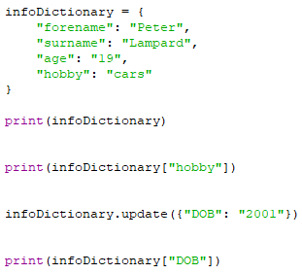
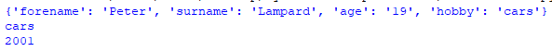
Exercise Solutions
Your code should look something like this:
And the outputs should look something like the ones below

Slide 10
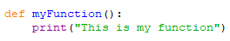
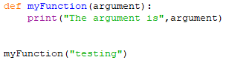
Functions
A function is a way of defining a block of code so that it only runs when called. A function would be defined using “def FUNCTIONNAME():” and then the code below would be indented to be contained within the function. You call a function in your code by putting functionName()
E.G:
Functions can also take in arguments, you do this by defining the function with an argument in the brackets, then putting something in the brackets when calling the function.
E.G:
Would return “The argument is testing”

Slide 11
Exercise – Functions & Arrays
Using what you’ve been shown so far, I have a short exercise for you
Make a program that takes a name from an array and inputs it into a function. The function should then return “Hi, my name is CHOSENNAME”.
You should start with the following array
namesArray = [“Hannah”, “Peter”, “Jarad”, “Wendy”]
The function should be named greetingFunc
REMEMBER: The function must be defined ABOVE the code that utilises it and don’t forget to indent code within the function

Slide 12
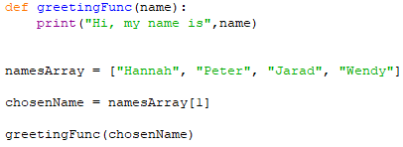
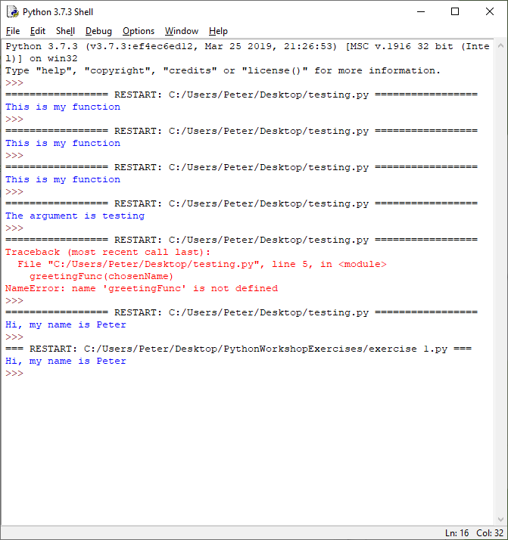
Exercise Solutions
Here is my code, yours should look something similar (you can have used any name from the array):
This is what the code should return:

Slide 13
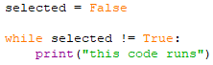
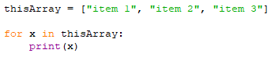
While/For Loops
A “while” loop is a loop of code that continues either while a condition is met, or until a condition is met. They are defined using “while” then the condition, such as “result != True” or simply “result” if it is set to True.
E.G:
A “for” loop is a loop that runs for a certain pre-set number of times or number of items in an element. It is often used for iterating through arrays.
E.G:
Would return each item in the array
There are also two important statements for loops. “break” and “continue”. Break stops a loop completely by “breaking” out of it. Continue moves on to the next iteration of the loop, skipping any code not yet executed in the current loop

Slide 14
Exercise – Loops
For this exercise, you will be using what you’ve learned so far about loops
The task is to create a for loop that iterates through the array below:
gameArray = [“Cyberpunk”, “Watch Dogs”, “Rimworld”, “Hitman”]
The loop should check if the game is Rimworld, and if it isn’t print “GAME NAME is not the correct game”. If the game IS Rimworld, it should print “Correct game found: Rimworld” and break the loop.
Don’t forget to indent your loops and statements!
Hint: Not all the games in the array should be outputting

Slide 15
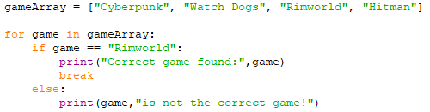
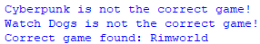
Exercise Solutions
Your code should be similar to the code below:
It should output something similar to this:

Slide 16
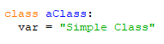
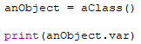
Basic Object Oriented Programming
Object oriented programming is where code is made up of objects, with properties and methods. I will only be covering the basics of what it is.
A class is a template for creating objects, with properties and methods. They are defined by putting “Class className:”
E.G:
You use classes to create an object. This is done by naming the object and defining it as a new instance of a class. Once an object is created, you can use it to access properties of that object using “objectname.property”
E.G:

Slide 17
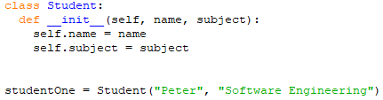
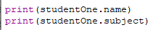
Basic Object Oriented Programming
Methods in Python are functions defined within the class that belong to that class. The important one for a class is the _init_ function, that is run when the class is first initialised. You use the “self” variable so the class knows to refer to the current instance when accessing properties/methods
E.G:
Once you have created an Object, you can access it’s properties using “objectname.property”
E.G:

Slide 18

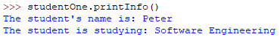
Basic Object Oriented Programming
To create a method of your own for objects, you would simply create it as a function within the class that takes self as an argument.
E.G:
You would then be able to call this method from a created object using “objectName.printInfo()”
E.G:

Slide 19
Extension Task - OOP
After the workshop do a bit more research into Python OOP and try and make your own class for some useful purpose.
This is not expected, you only need to give this a go if you want to learn a bit more about OOP
Any questions just post in the first year/support channels on Discord

Slide 20
Thanks for listening
DevSoc Discord: discord.gg/NTCvrKK
DevSoc Email: devsoc@ntu.ac.uk

